Slide 1
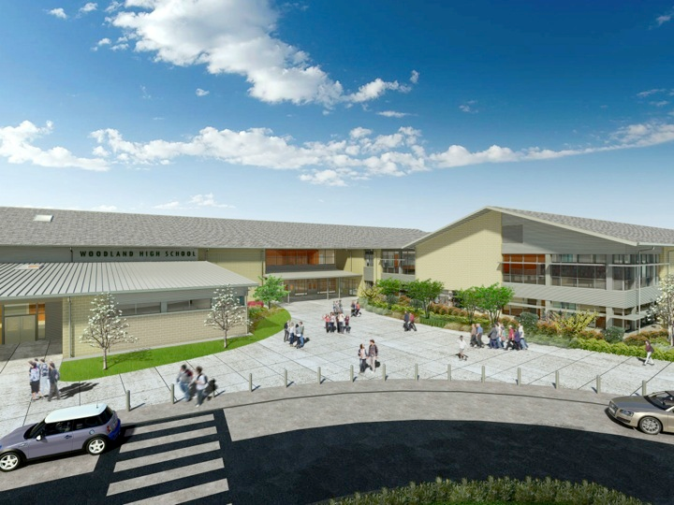
Woodland Public Schools
Facilities and Safety Report
January 2018

Slide 2
Reunification drill
I have been participating with Kalama schools on a reunification exercise scheduled for May. We have been meeting monthly to finalize the details. This exercise will also assist Woodland Schools in hardening our reunification strategy and procedures. The reunification strategy is organized virtually the same at any location only the key players change. Additionally, we have prepped two reunification “Go Kits”. One that will reside at WHS in the main electrical room and the second at the Facilities Office at the Middle School. In the event of a reunification event, both kits are easily transported to the reunification site.
Rekey
In order to improve safety at the schools, card key readers were installed last summer to more accurately control and limit access to the schools. Once all of the readers were up and running and all bugs worked out, the intent was to rekey all of the exterior locks at each school. This action virtually renders all A keys useless (excluding interior doors). Last week we completed this activity at WMS and will schedule WIS and WPS in the very near future.
Remote Viewing of Schools Cameras
I’ve connected with IT and Woodland Police to allow our surveillance cameras to be viewed by dispatch at the police station. This ability to pinpoint problem areas in the schools remotely can aid the police tremendously and shave critical time off there response to a particular area in the school. Since this information will be available via a web browser IT is currently ensuring the network connection security then we will be ready to deploy and train WPD on the arrangement of the cameras and location ID.
FACILITIES REPORT

Slide 3
Facilities Report Continued
Lighting Controllers and UPS
AET replaced the logic chips in the LED lighting controllers for 4 of the WHS lighting systems. These systems have been problematic since there installation. Quite often we have been experiencing a “lock up” of the lighting controllers that renders the wall controllers useless. To temporarily correct this problem, normal and emergency power has to be disconnected from the controller essentially rebooting it. Eaton technicians, the OEM for the panels are doing the replacement.
Emergency Planning
The new emergency planning policy is being presented for board review at the 2/26 board meeting. The policy is the lead document in a new series of emergency procedures and guidelines created for the district. The policy is followed by a new Procedure, District Emergency Operations Plan and school level Emergency Response plans. School level plans have detailed information for Standard Response Protocol, reunification planning, hazard probability modeling, emergency flow charts, first aid and other programs to support the schools from a safety perspective.
The French are coming!
The WHS commons will be undergoing another awesome transformation this next Saturday, (February 24) as Grace Church will be temporarily relocation the building to France for the evening. This transformation will be complete with Eiffel Tower and many other artistic French twists. If its in line with the previous 14 venues, I’m sure it will be a fantastic memory for the daughters and dads alike. Due to the popularity there are now 2 sessions. One is currently sold out (700 tickets) and the second has 200 left. UOI, OUI.

Slide 4
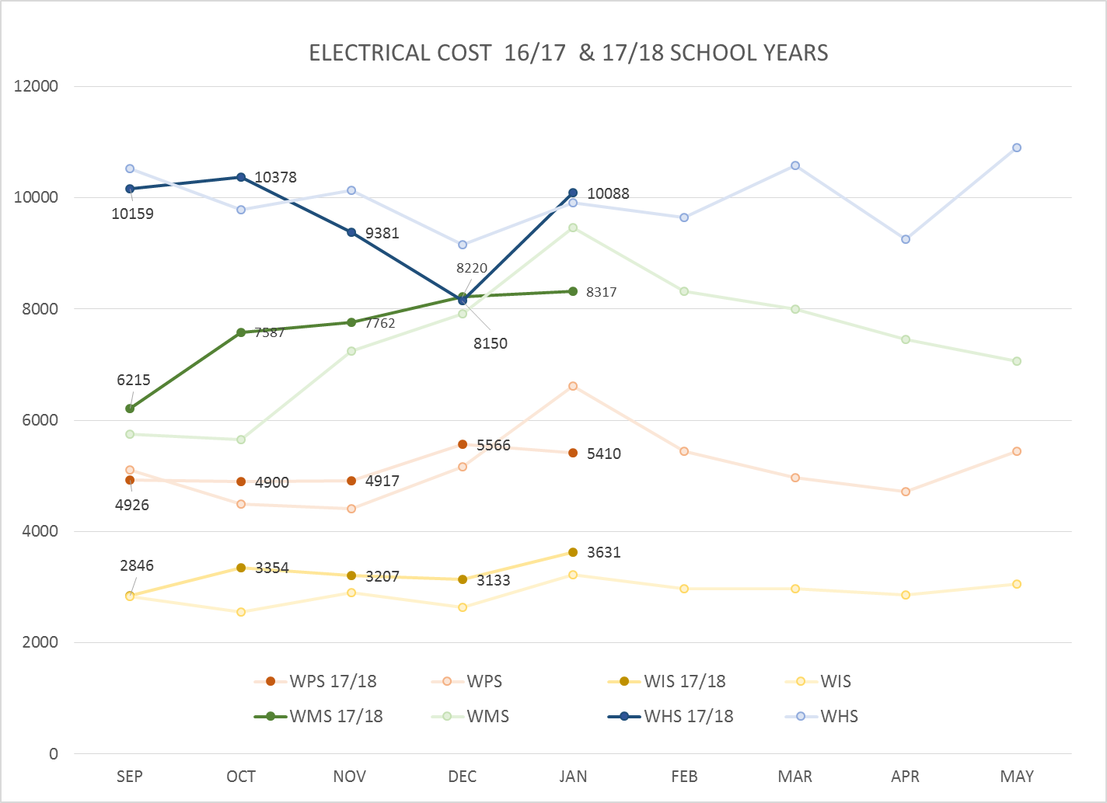
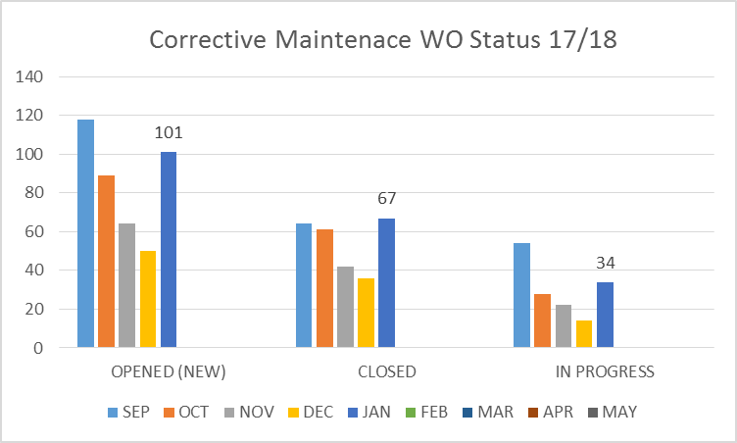
FACILITY CHARTS – POWER COST AND WORK ORDER STATUS

Slide 5
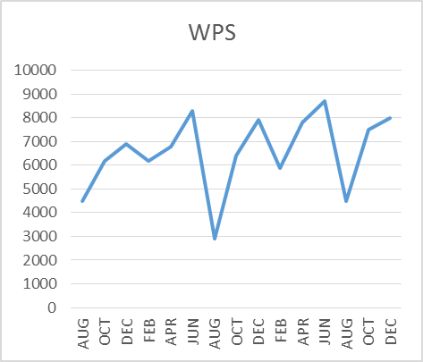
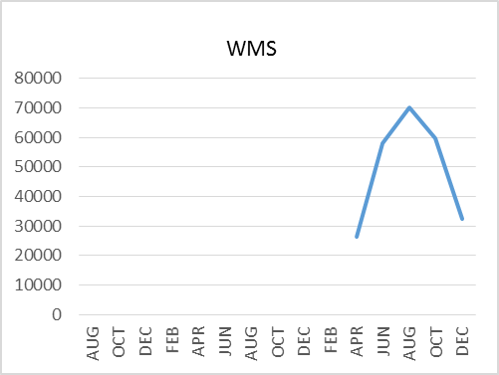
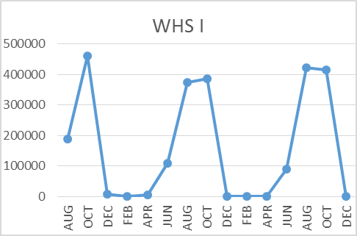
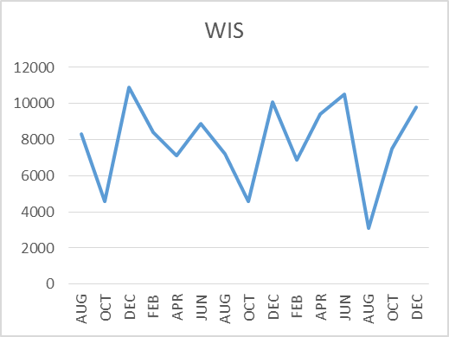
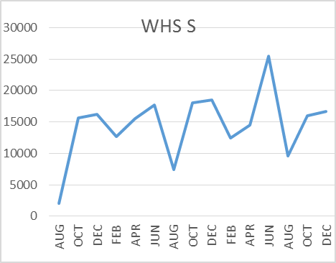
FACILITY CHARTS –
WATER USAGE
WHS, WIS, WMS, WPS
Water charts are updated every two
months, next update to these charts
in March 2018
The WMS chart includes; 755 Park high and low flow, BO and Team High, Pit house, bus barn, athletic field and DO. All of these meters are totaled on the WMS graph but each data point is recorded separately to aid in identifying leaks.

Slide 6
SAFETY REPORT
Accidents/Incidents
There were 4 student and 16 staff incidents/accidents for the month.
Staff Accidents/Incidents
WPS - Student behavior – contusions (14)
WPS - Student behavior – laceration
WHS - Maintenance worker got oil in his eye while adjusting door cylinder
Student Accidents/Injuries (8)
WPS – While playing on a chair, student pinched toe and foot by own weight (removed shoes)
WIS - Student hit mouth while using horizontal bar, laceration and chipped tooth
WMS (PIT) - Student tried to “wheelie” over speed bump with wheelchair, lost control and crashed. Bruised ego
WHS - Student punched locker, bruised hand

Slide 7
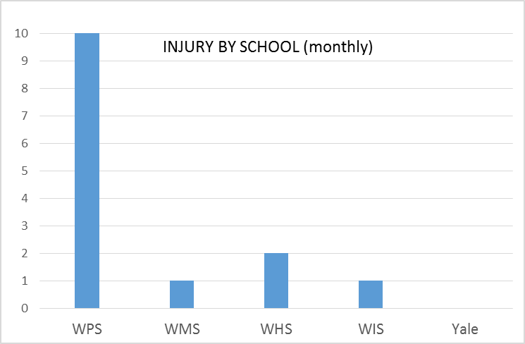
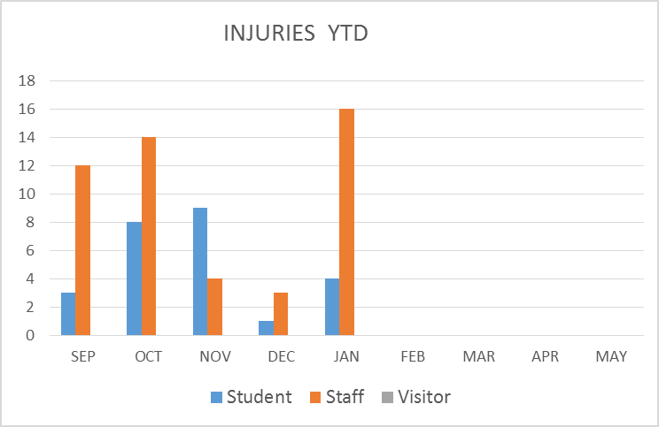
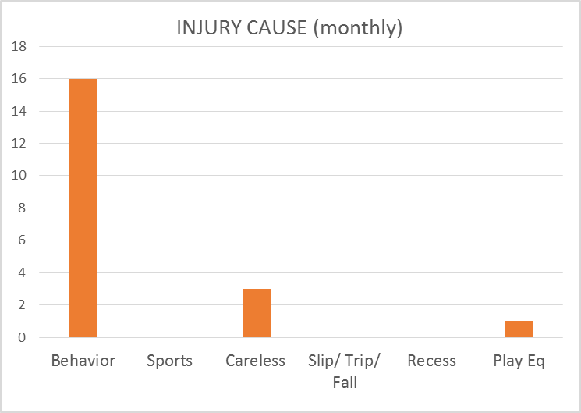
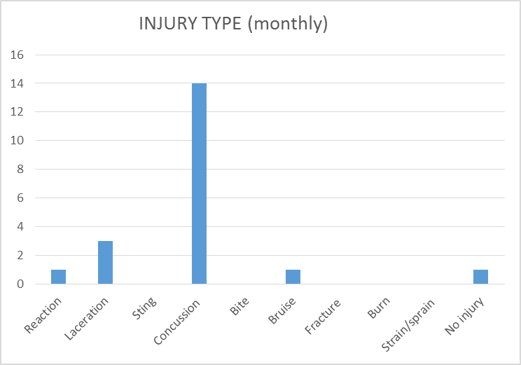
SAFETY CHARTS

